Slide 1
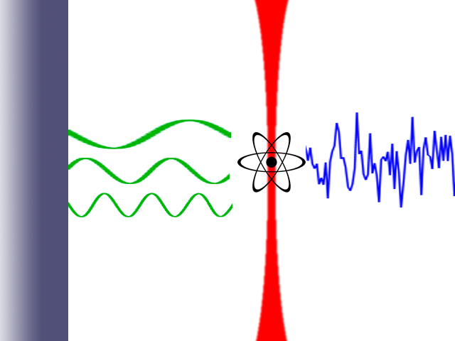
The Casimir Effect
Surface
Optical Lattice
Vacuum Fluctuations
All Frequencies Allowed
Standing Waves Only
Net Force

Slide 2
Surface
Strontium
Emission
Spectrum
Potential
Energy

